Slide 1

Multiple Disease Prediction System
By Santhosh Kumar

Slide 2
Leveraging Machine Learning for Early Detection
Early Diagnosis
Improved Outcomes
The Multiple Disease Prediction System utilizes machine learning algorithms to identify potential health issues at their early stages.
Early detection allows for timely interventions, improving treatment outcomes and potentially preventing disease progression.

Slide 3
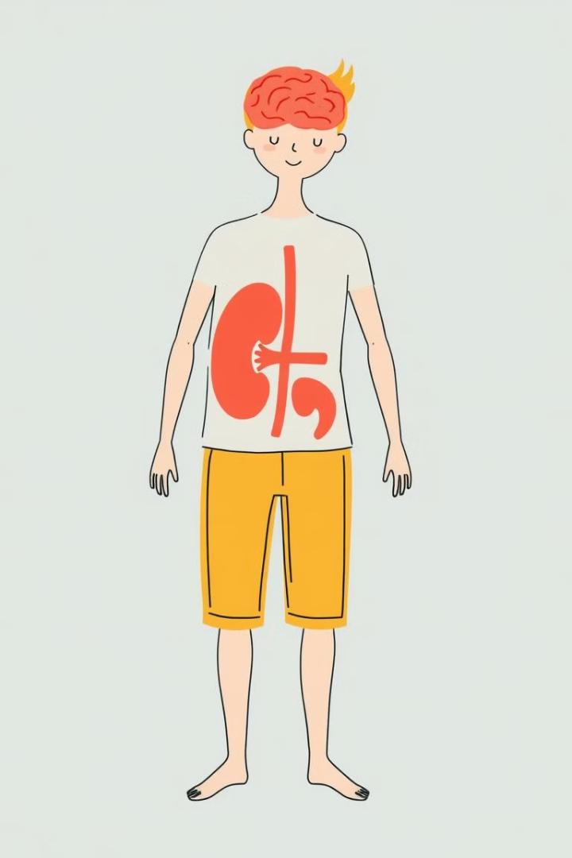
Predicting Kidney, Liver, and Parkinson's Diseases
Kidney Disease
Liver Disease
The system analyzes patient data to predict the likelihood of developing chronic kidney disease.
It can also assess risk factors associated with liver diseases, such as hepatitis and cirrhosis.
Parkinson's Disease
The system can detect potential early signs of Parkinson's disease, aiding in prompt treatment.

Slide 4



Built with Streamlit and Python
Python
Streamlit
The system is built using the Python programming language, known for its versatility and data science capabilities.
Streamlit provides a user-friendly framework for building interactive web applications, enhancing user experience.

Slide 5

Processing User Inputs, Predicting Diseases
User input data is collected through a web interface, encompassing medical history, symptoms, and lab results.
The system employs trained machine learning models to analyze the processed data and generate predictions.
1
2
3
The collected data is processed and pre-processed to prepare it for machine learning model analysis.

Slide 6



Utilizing Random Forest and XGBoost Models
Random Forest
XGBoost
This model utilizes multiple decision trees to make predictions, enhancing accuracy and reducing overfitting.
This model utilizes gradient boosting algorithms to improve prediction accuracy and handle complex datasets.

Slide 7


Providing Risk Probabilities for Diseases
Risk Assessment
1
The system provides risk probabilities for each predicted disease, empowering users to understand their individual risk.
Personalized Insights
2
This information allows users to make informed decisions about their health and seek appropriate medical advice.

Slide 8
Enhancing Healthcare Efficiency and Accessibility
Improved Efficiency
1
Early disease detection can reduce unnecessary medical tests and procedures, improving healthcare efficiency.
Increased Accessibility
2
The web-based system provides wider access to predictive health services, benefiting users in remote locations.

Slide 9

Conclusion
The Multiple Disease Prediction System holds immense potential for revolutionizing healthcare by empowering early detection and informed decision-making.

